Slide 1

Making My First Shiny App
Bryson Mwamburi
Data Scientist, Kantar
Nairobi SatRday,
04/09/2021

Slide 2
Contents
Personal Introduction
Introduction to Shiny
Use Cases
Structure of a Shiny App
Making our first Shiny App
Question and Answer session

Slide 3

Personal Introduction
Bryson Mwamburi is a Data Scientist at Kantar; the world’s leading data, insights and consulting company that helps clients understand people and inspire growth. This is achieved through evidence-based market research and a wealth of talent spanning 90 markets around the globe.
A recipient of Facebooks Secure & Private AI, Intel’s Edge AI scholarships and a Big Data Mastery Award from IBM, he contributes to the client and business success through analytics.
Away from wrangling insights, Mwamburi enjoys motorcycling, rugby and swimming, having represented the country in the latter. An avid reader and self-proclaimed master chef, he pairs both with a good glass of wine and the occasional tinge of a sunset.

Slide 4
Introduction to Shiny
What
How
Why
Shiny is a web-based platform for the deployment of interactive visualizations, analytics tools
Shiny integrates R Code, output with easy-to-use html elements to build interactive web pages
Shiny allows our stakeholders to access information, analytics on demand
Enhanced scalability <- happier clients, more time to create cool stuff

Slide 5
Use Cases
Typically used for sharing insights
This is done through interactive apps,
App interaction through :
Uploading data
Setting parameters through filters
Interactive charts
Endless capabilities!

Slide 6
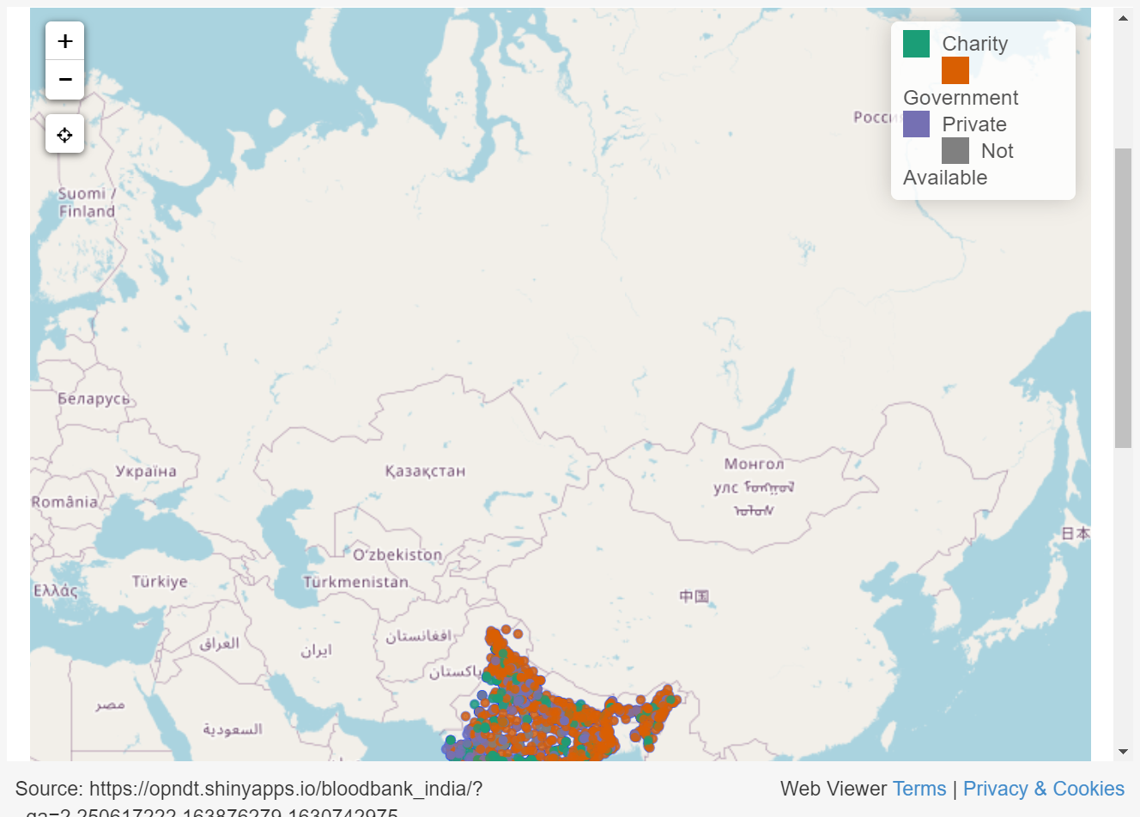
Use Cases
Open data : Visualizing data for the public good
Visualization of blood banks in India
The main motivation behind this simple shiny application is to make it easier to locate blood banks in India

Slide 7
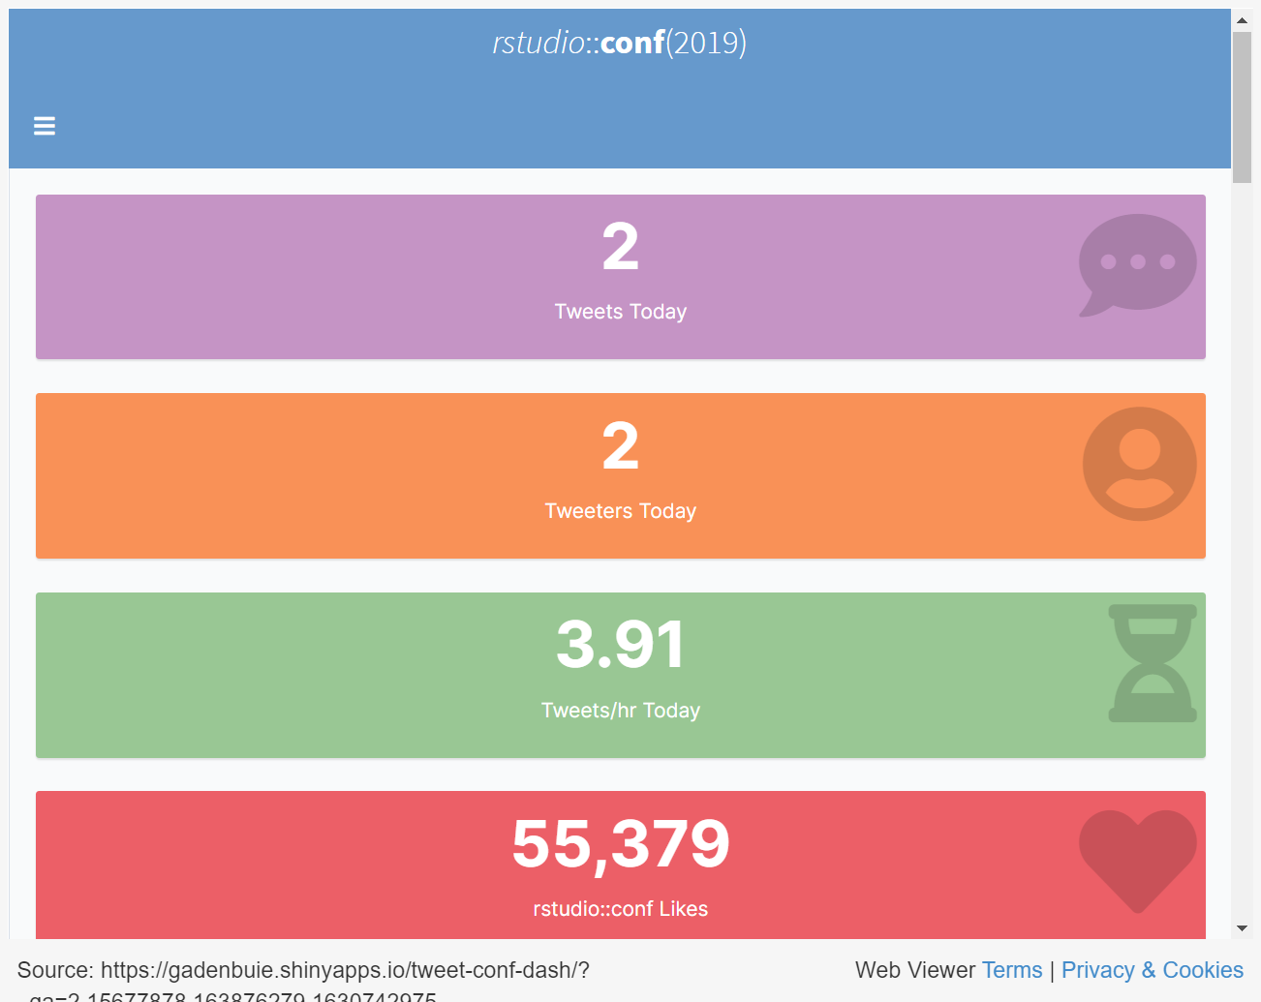
Use Cases
Dashboard : Social Media monitoring
Visualization of tweets made around an R conference
A Shiny app for tracking tweets around conferences and events

Slide 8
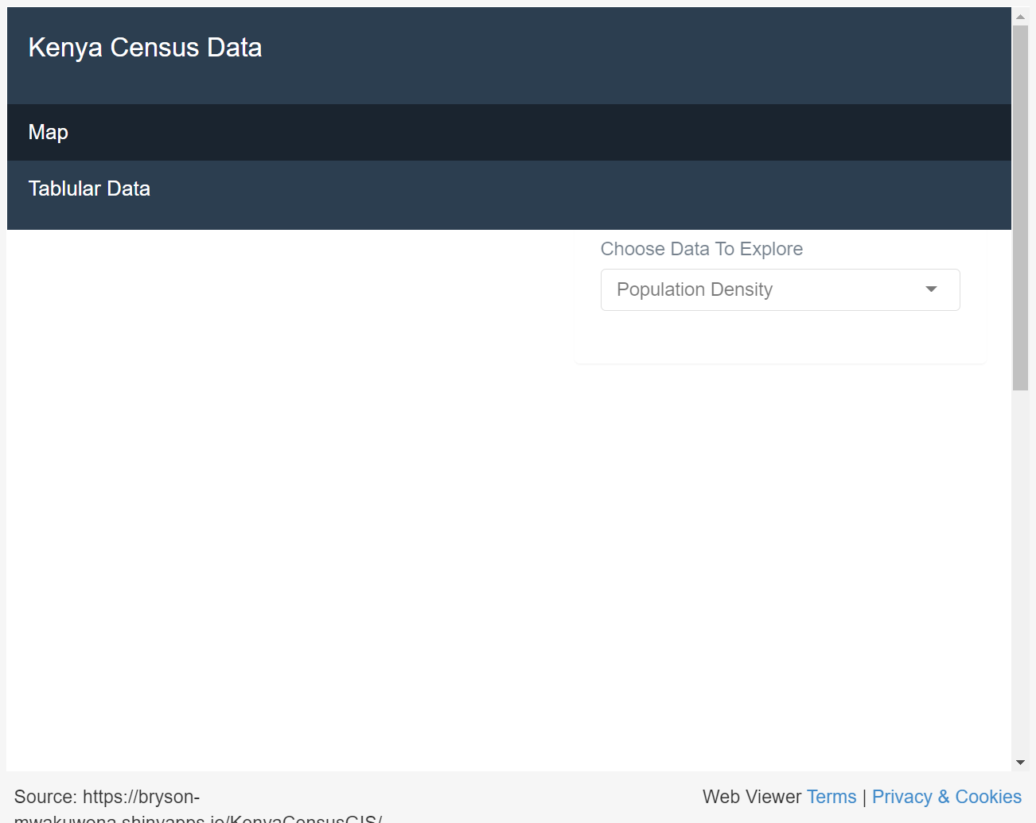
Use Cases
Dashboard: Open Data
Visualization of Kenya Census 2019 Data
A Shiny app for visualizing Kenya Census 2019 data, with focus on education, IT penetration

Slide 9
Shiny App structure
The UI section
The user interface of the default app uses the fluidPage()
Several layouts are available depending on the apps goal
The server function
The server function contains the code behind the webapp
Where all the magic happens

Slide 10
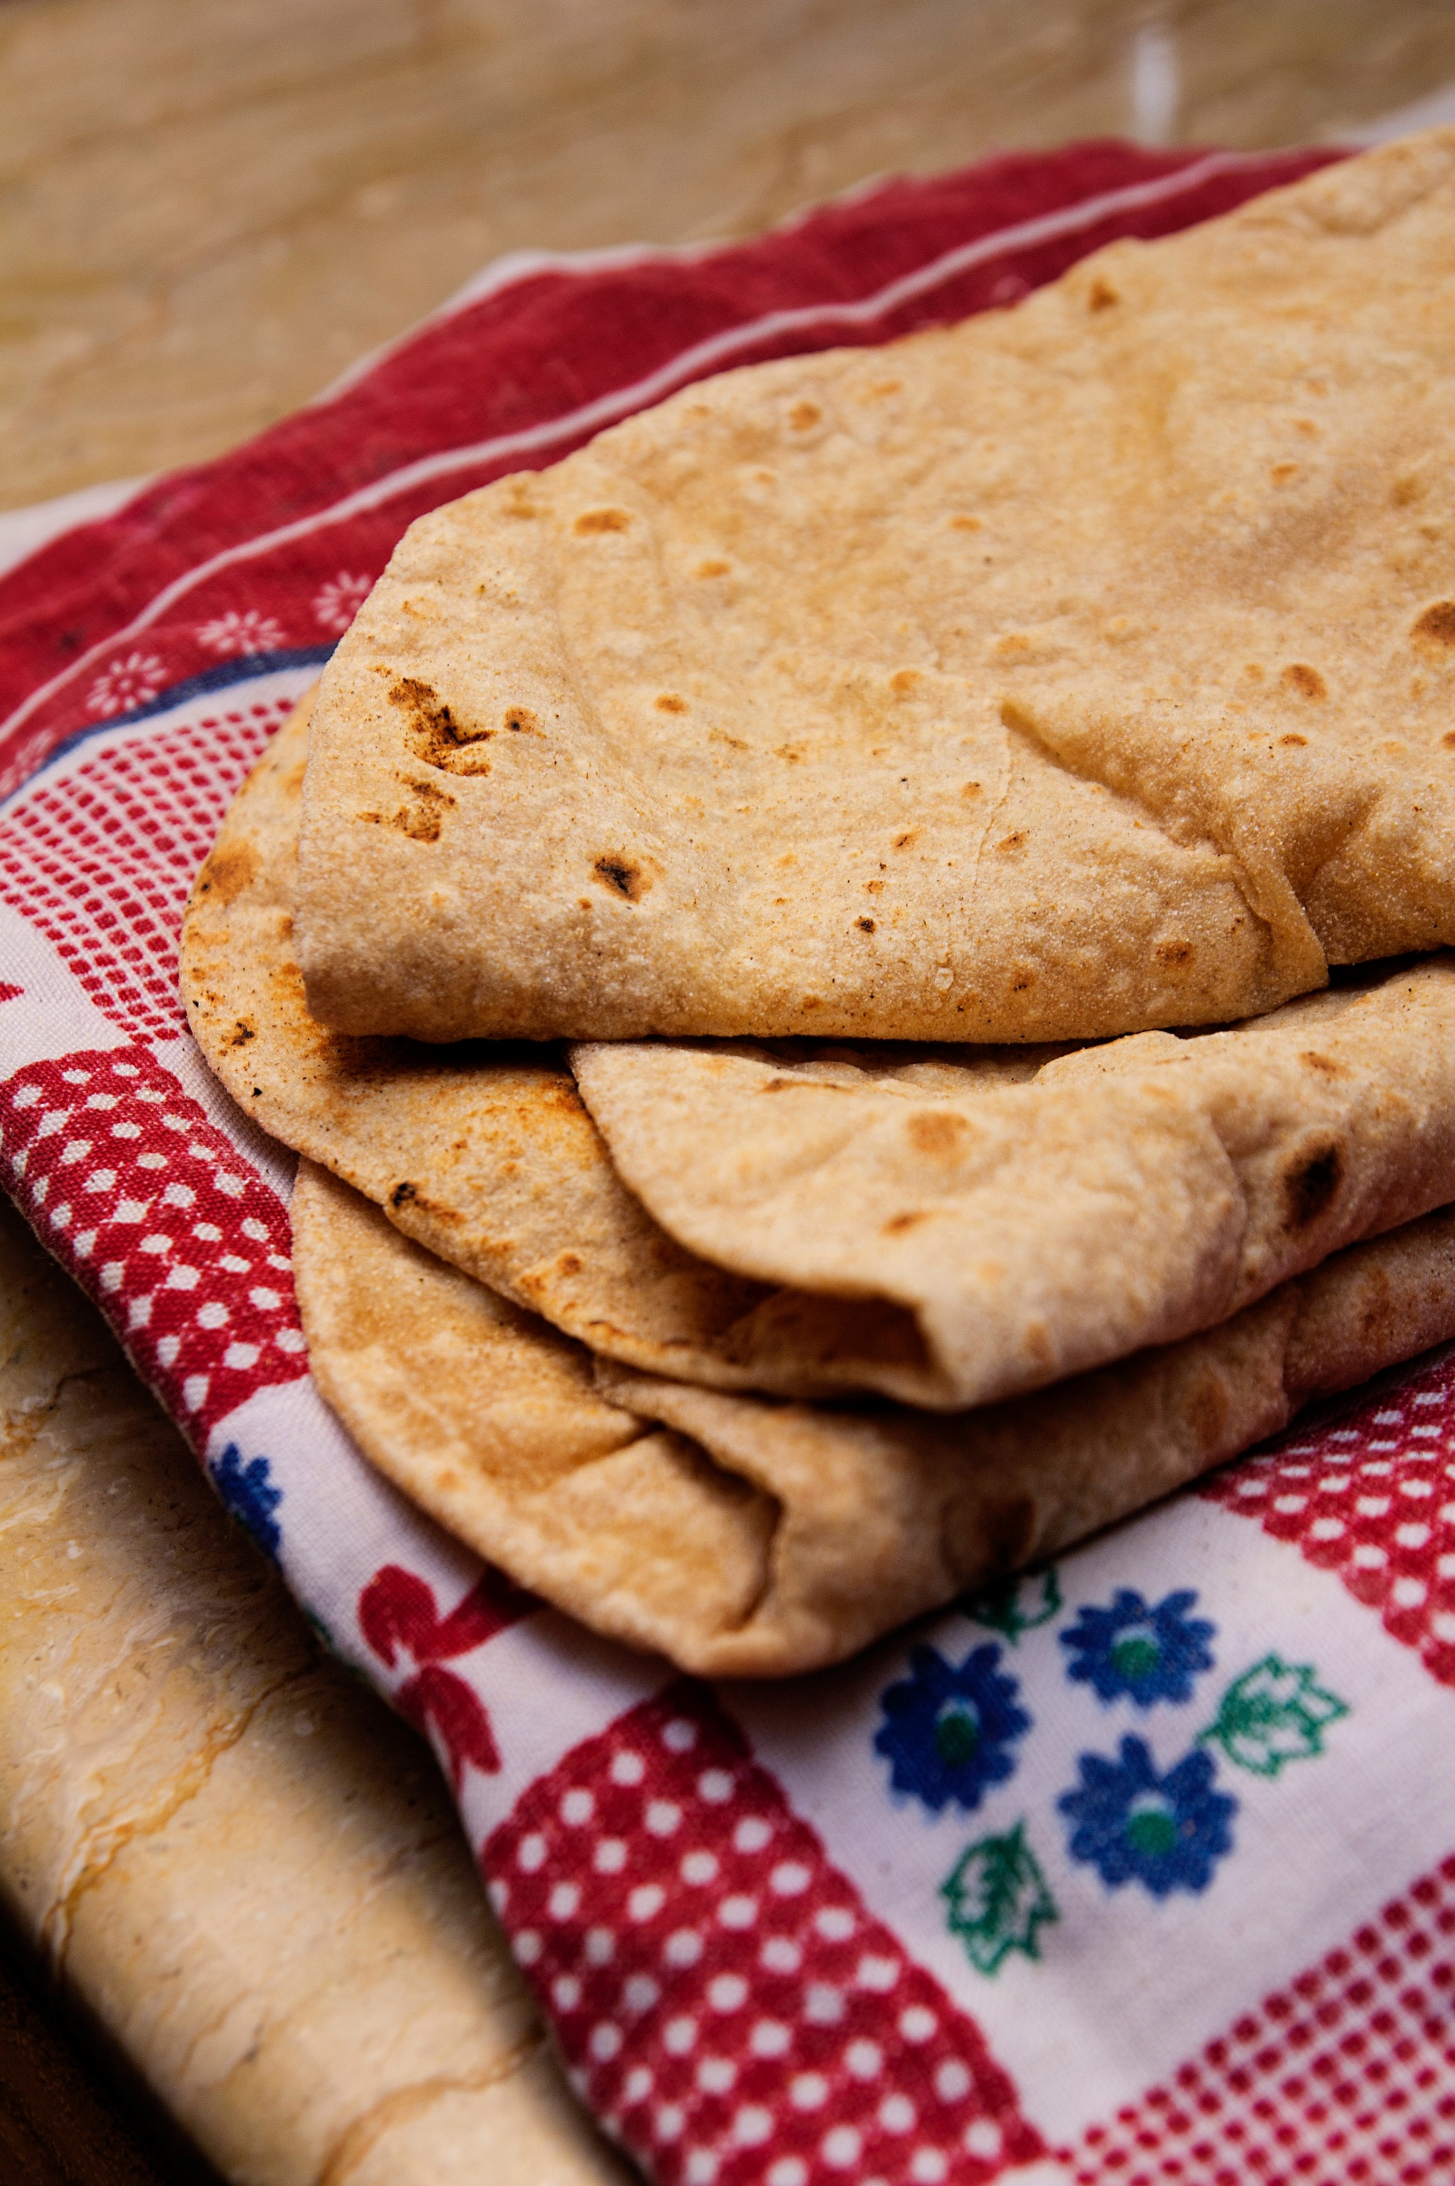
Shiny App structure
The UI section
The user interface of the default app uses the fluidPage()
Several formats to the Ui are available as default
Contains input and output markers, elements

Slide 11
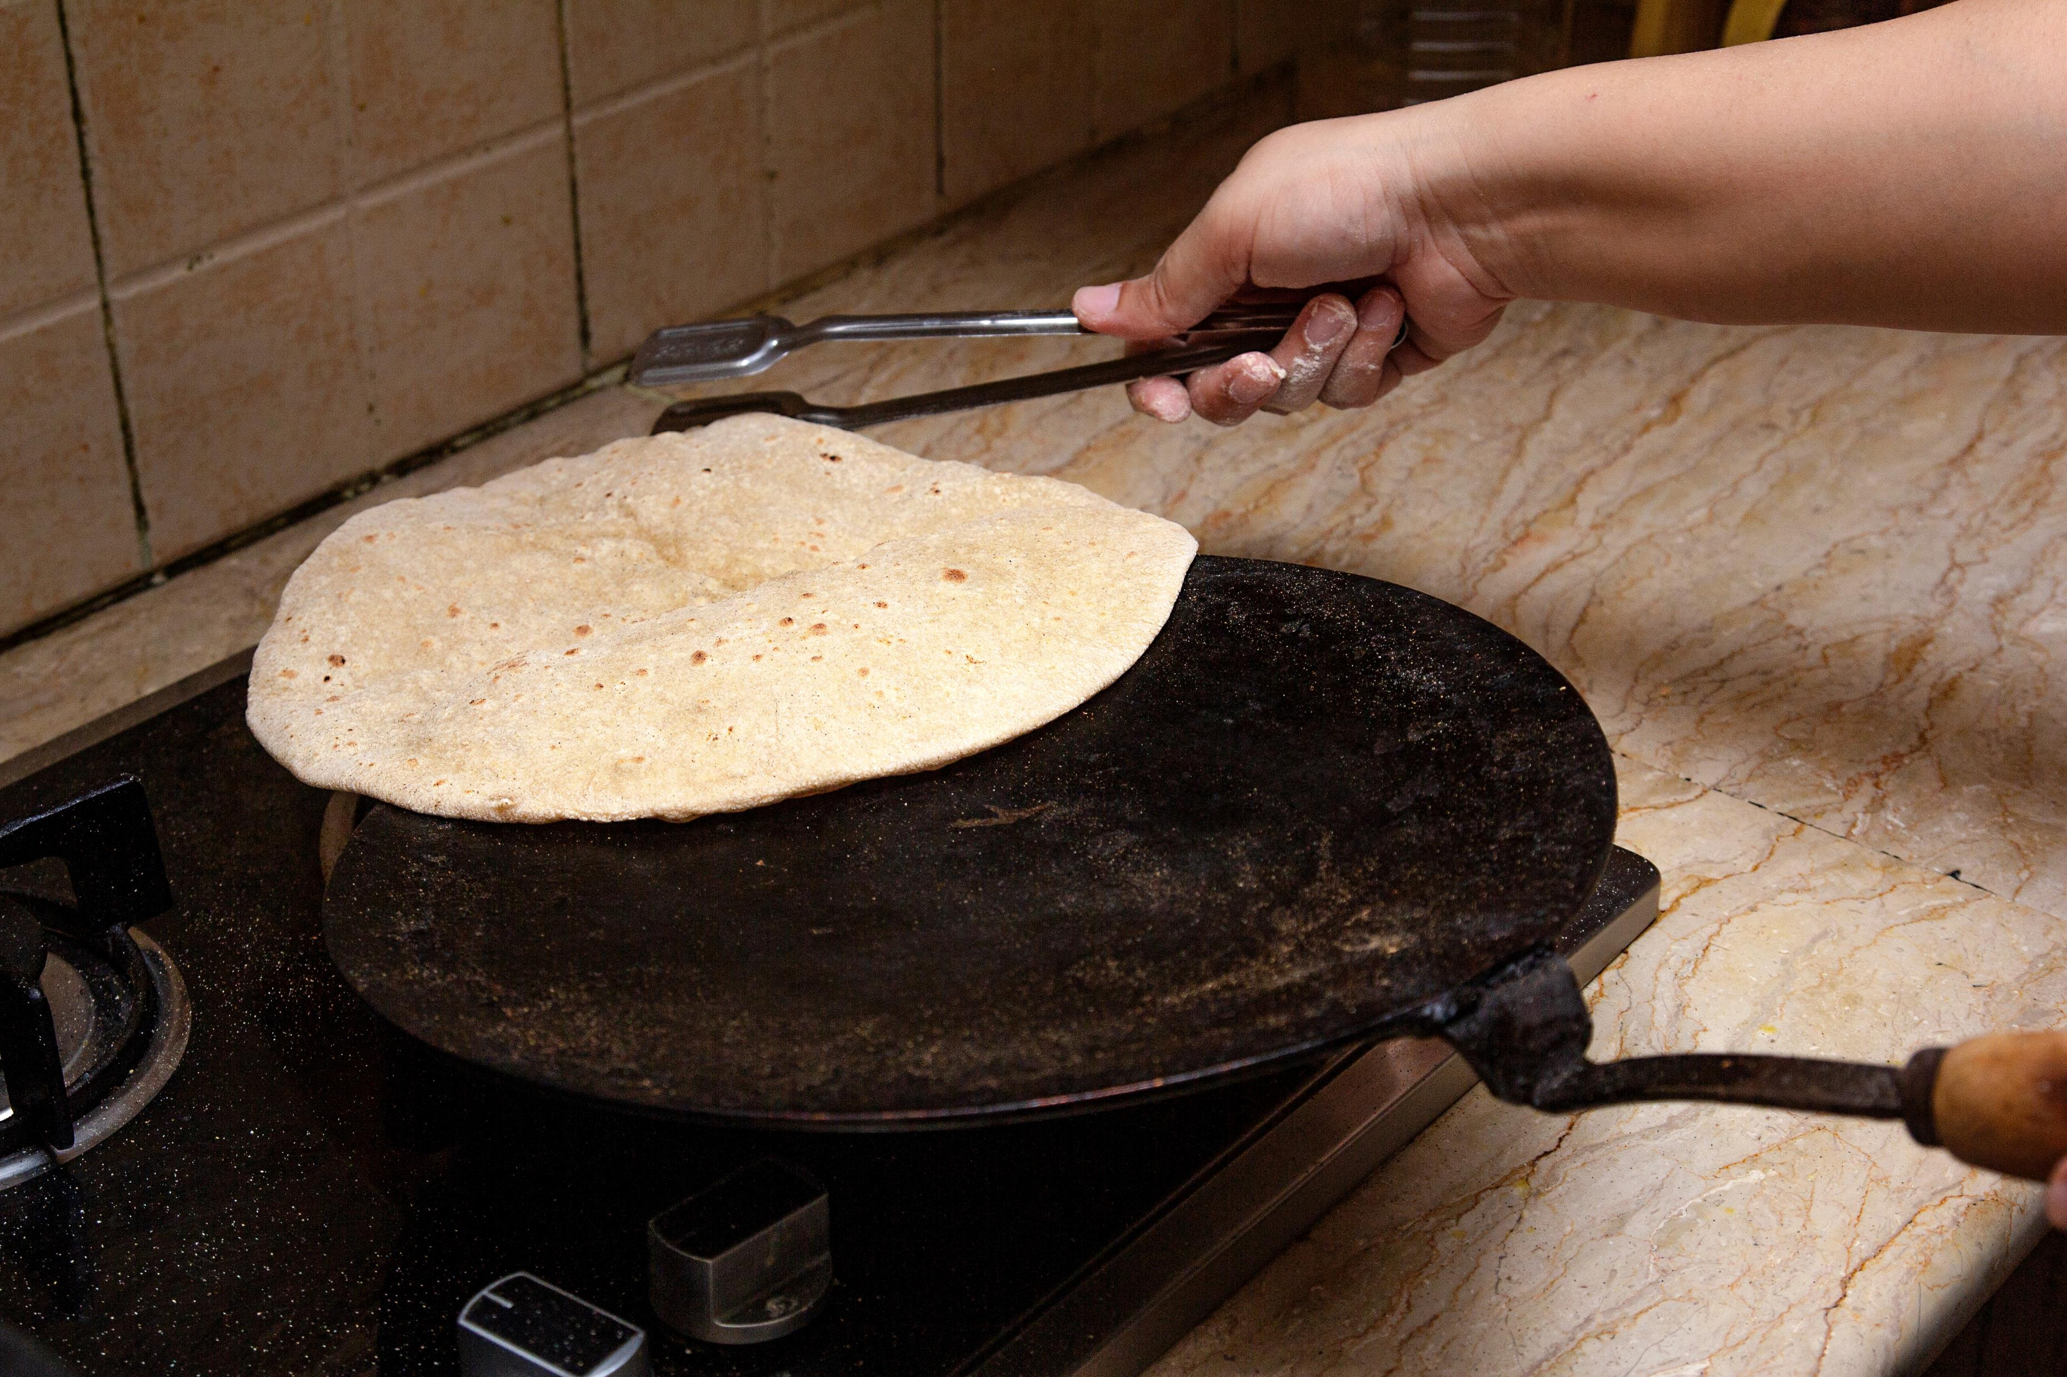
Shiny App structure
The Server Section
Where the magic happens
Linked to the UI via tags/elements
Allows for reactive behaviour

Slide 12
Making Our First Shiny App
Please ensure you have installed the shiny package
Follow through ☺

